Slide 1

Project Domain : -
HR Analytics
Project Title : -
Employee Retention
Group 5
Manasi More
Snehal Dumbre Pravin Kudale Sarthak Gowda
KP1 6
KP1 5
KPI 1
KP1 6
KP1 2
KP1 3
DASHBOARD
KP1 4
INTRODUCTION
Mentor Name : -
Mr. PUSHPARAJ RATHORE
Ms. DIPTI SINHA

Slide 2

Employee Retention refers to organization’s ability to retain its employees and prevent them from leaving their jobs.
5 Benefits
Cost Management
Early Identification of Turnover Risks
KP1 6
KP1 5
KPI 1
KP1 6
KP1 2
INTRODUCTION
KP1 3
DASHBOARD
KP1 4
Trend Analysis
Strategic Workforce Planning
Benchmarking

Slide 3






WHAT MAKES EMPLOYEES LEAVE?
LACK OF GROWTH OPPURTUNITIES
KP1 6
POOR MANAGEMENT
KP1 5
KPI 1
KP1 6
KP1 2
INTRODUCTION
KP1 3
DASHBOARD
KP1 4
BETTER JOB OPPURTUNITIES
WORKPLACE CULTURE
LOW JOB SATISFACTION

Slide 4
KEY FEATURES
Attrition Metrics
Employee Satisfaction Scores
Performance Metrics
Tenure Analysis
Training and Development Impact
Leadership Effectiveness
Predictive Analytics
KP1 6
KP1 5
KPI 1
KP1 6
KP1 2
INTRODUCTION
KP1 3
DASHBOARD
KP1 4

Slide 5
KEY METRICES
Average Attrition rate for all Departments
Average Hourly rate of Male Research Scientist
Attrition rate Vs Monthly income stats
Average working years for each Department
Job Role Vs Work life balance
Attrition rate Vs Year since last promotion relation
KP1 6
KP1 5
KPI 1
KP1 6
KP1 2
INTRODUCTION
KP1 3
DASHBOARD
KP1 4

Slide 6
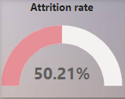
Observation
Average Attrition Rate for all Departments is 50.21%.
Suggestion
Comprehensive Employee Engagement Programs
Flexible Work Arrangements
Regular Feedback
Transparent Communication
Conclusion
Attrition rate is neither positive or negative. By promoting employees can either help to decrease the attrition rate.
KP1 6
KP1 6
KP1 5
KP1 2
KPI 1
KP1 3
DASHBOARD
KP1 4
INTRODUCTION

Slide 7

Observation
Average Hourly Rate of Male Research Scientist is 114.45 and Female Research Scientist is 115.93.
Suggestion
Equal Pay Analysis
Professional Development Opportunities
Employee Feedback
Conclusion
The slight difference in average hourly rates between male and female research scientists warrants attention and ongoing analysis.
Gender equity in compensation and opportunities is crucial for fostering a diverse and inclusive workplace.
Implementing targeted initiatives for professional development and work-life balance can positively influence employee retention and overall job satisfaction.
KP1 6
KPI 1
KP1 6
KP1 5
KP1 3
KP1 2
DASHBOARD
KP1 4
INTRODUCTION

Slide 8
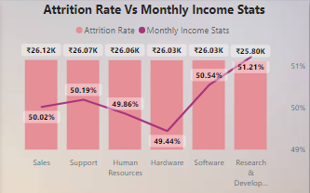
Observation
Attrition rate in Hardware Department is 49.44% which is Lowest and in R&D Department is 51.21% which is Highest.
Employees in the Hardware department, on average, earn a marginally higher income than their counterparts in R&D.
Suggestion
To address the higher attrition rate in R&D department , there’s need to explore and implement flexible working hours or remote working options.
Conclusion
A comprehensive retention strategy should address the unique needs of each department, focusing on factors such as workplace culture, career development, and job satisfaction.
KP1 6
KP1 6
KP1 5
KP1 2
KP1 4
KP1 3
KPI 1
DASHBOARD
INTRODUCTION

Slide 9
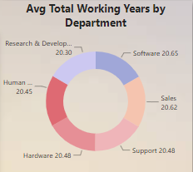
Observation
As per Observations, we can see that Avg working years for each department is 20 years.
Suggestion
Encourage continuous skill development programs to keep employees updated with evolving industry trends and technologies over their lengthy tenure.
Conclusion
To capitalize on this wealth of experience, organizations should focus on succession planning, provide continuous career development opportunities, and adapt work arrangements to meet the evolving needs of employees with long tenures. This approach ensures a sustainable and resilient workforce for the future.
KP1 6
KP1 5
KPI 1
KP1 6
KP1 2
KP1 3
INTRODUCTION
DASHBOARD
KP1 4

Slide 10
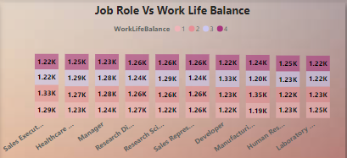
Observation
The count of work-life balance perceptions varies significantly across different job roles within the organization.
Some roles may report higher satisfaction with their work-life balance, while others may express challenges in achieving a healthy equilibrium.
Suggestion
Companies should focus on improving the work-life balance for Sales Representatives and Research Director since they have significant counts in lower rating.
Conclusion
While there is general uniformity in work-life balance across different job roles, targeted interventions can be made to uplift those with lower ratings to ensure employee satisfaction and productivity.
KP1 6
KPI 1
KP1 6
KP1 2
KP1 3
INTRODUCTION
DASHBOARD
KP1 5
KP1 4

Slide 11
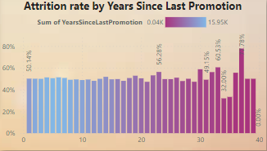
Observation
Attrition rate is relatively stable for almost 20 years which is around 50% and then it starts to fluctuate.
There is sudden spike in attrition rate which is 78% at approx. 30-35 years and then it drops to 50% after sudden spike.
Suggestion
Investigate for underlying causes of significant increase in attrition rate at around 30 years. Implement strategies to maintain or improve employee retention, especially for those who have not been promoted for long time.
Conclusion
Addressing factors contributing to the spike and enhancing employee retention strategies could be crucial.
KP1 6
KPI 1
KP1 2
KP1 6
KP1 3
DASHBOARD
KP1 5
KP1 4
INTRODUCTION

Slide 12
STRATEGIES FOR EMPLOYEE RETENTION
Offer Competitive Compensation and better Benefit Packages
Provide Opportunities for Growth and Development
Foster a positive Work Culture
Recognize and reward good performance
Communicate Effectively

Slide 13
CONCLUSION
In conclusion, the Employee Retention Dashboard is a pivotal tool, offering real-time insights crucial for strategic decision-making in employee management.
By consolidating key metrics, the dashboard empowers organizations to proactively address challenges, enhance job satisfaction, and retain top talent.
Its dynamic features facilitate a responsive approach to workforce dynamics, promoting a positive organizational culture.
Through continuous monitoring, the dashboard becomes an invaluable asset, guiding interventions and fostering a resilient workforce.
In a fast-paced and competitive business environment, the Employee Retention Dashboard emerges as a vital resource for organizations committed to maintaining a satisfied and engaged workforce.

Slide 14
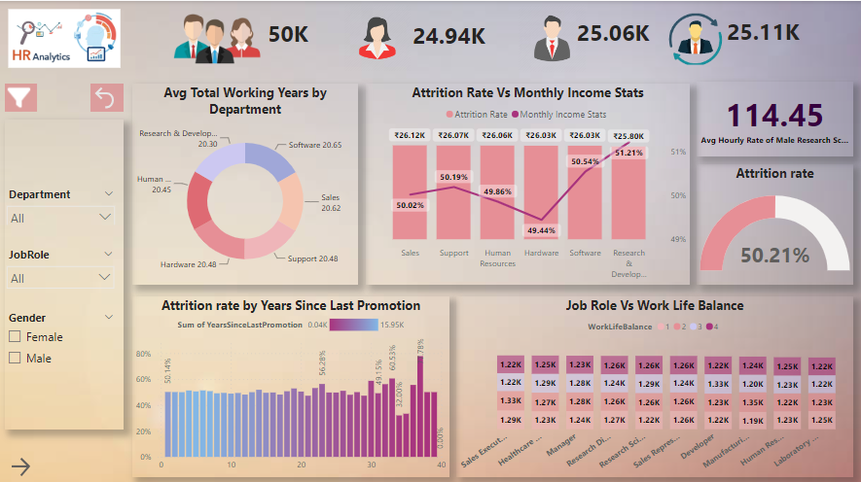
Project Title Employee Retention
Group 5
MANASI MORE
SNEHAL DUMBRE PRAVIN KUDALE SARTHAK GOWDA
KP1 6
KP1 3
KPI 1
KP1 6
KP1 4
KP1 2
INTRODUCTION
DASHBOARD
Mentor Name
PUSHPARAJ RATHORE

Slide 15


